Slide 1
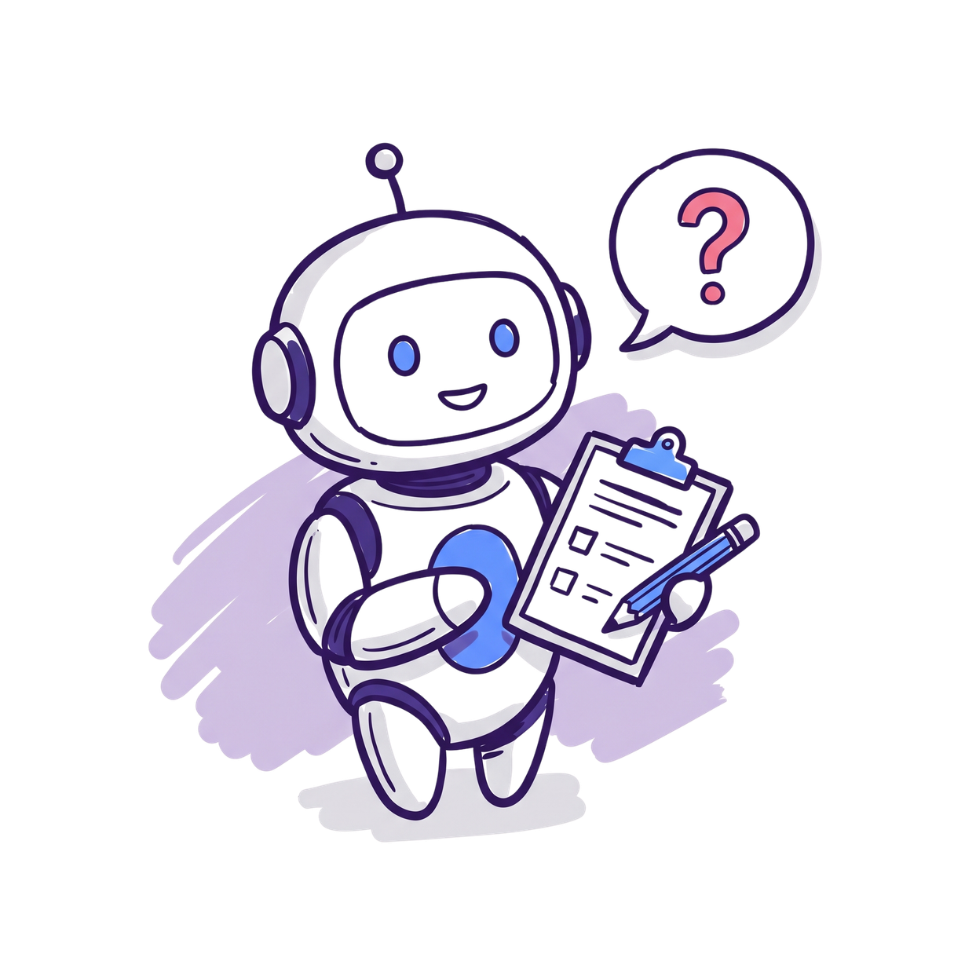
AI Foundations
Practical AI tips and workflows to save you time
PRESENTED BY : DR CARLA ROETS

Slide 2
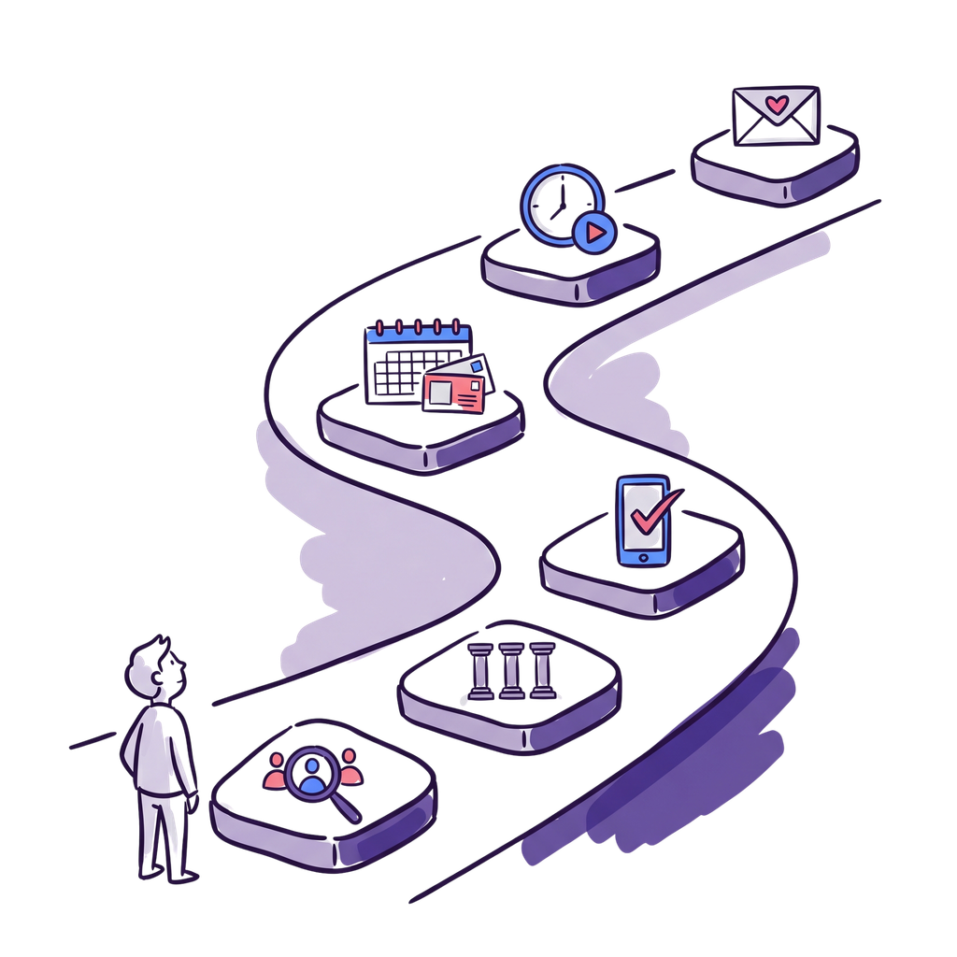
TODAY
What we'll do today
What AI is, and how we got here
The five tools, and the one data rule
How to talk to it so you get useful answers
Copilot and Gemini up close, plus your first Gem

Slide 3
AI FUNDAMENTALS

Slide 4
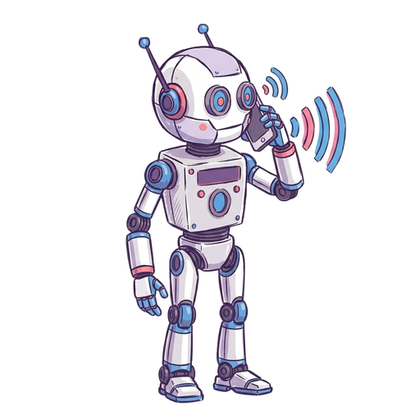


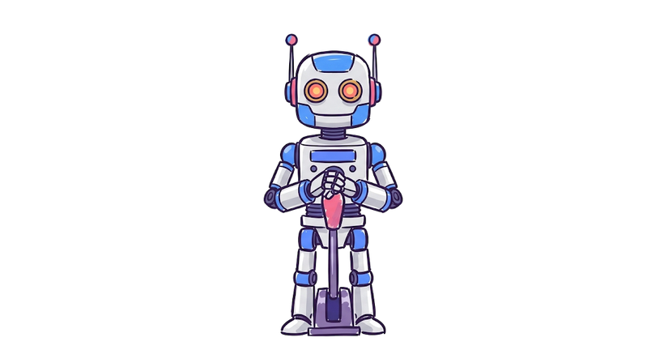
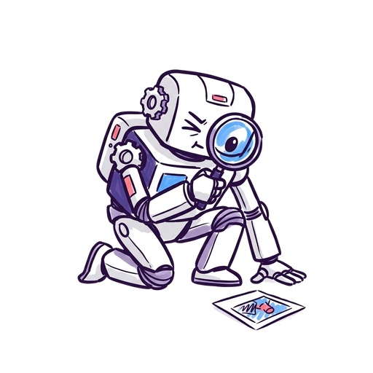

A BIT OF HISTORY
Decades of rules-based AI: computers following hand-written instructions
Recommendation engines suggest what you'll want next
AI learns to recognise images by studying millions of examples
2012
2006
1960s+
1956
1997
2011
The term "AI" is coined at Dartmouth College
Deep Blue beats world chess champion Kasparov
Siri arrives - talking to your phone goes mainstream

Slide 5
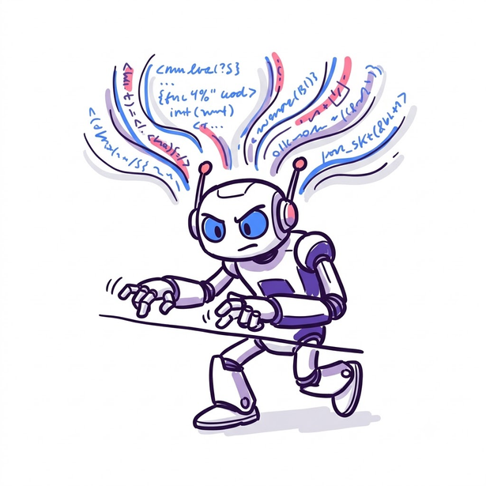
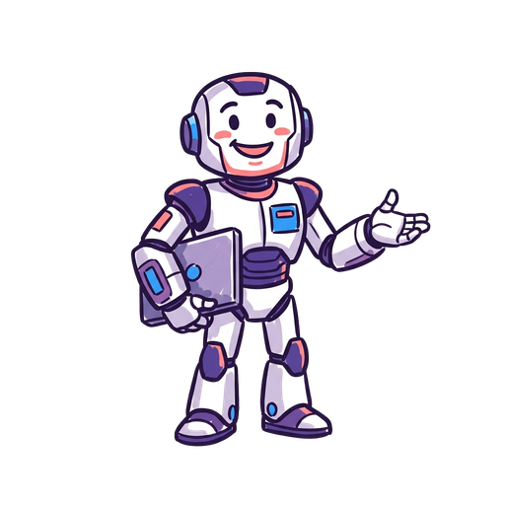
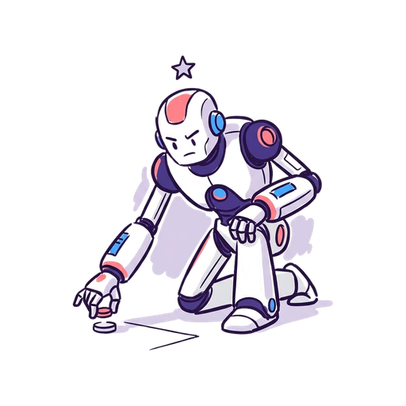
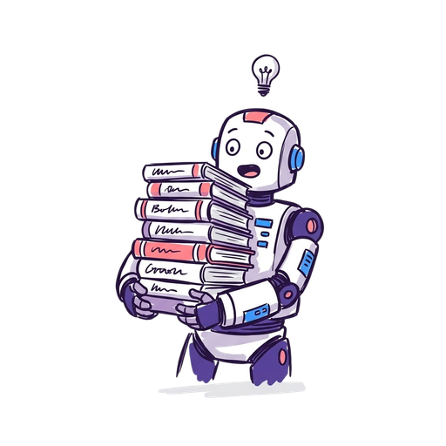
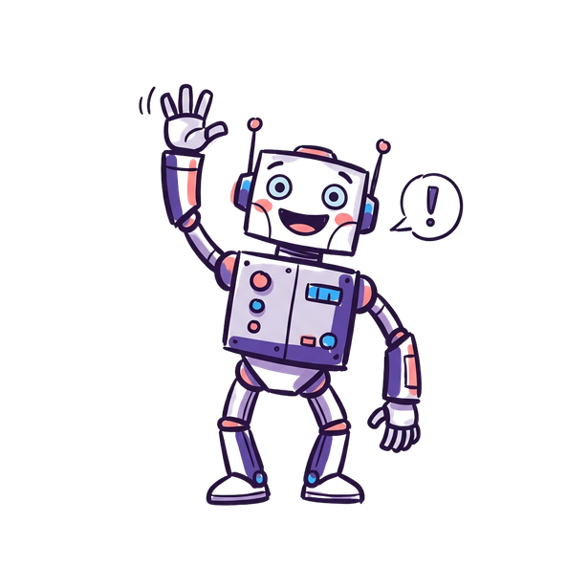
A BIT OF HISTORY
Researchers find a way for AI to learn from vast amounts of text: the Transformer
ChatGPT arrives - the first time anyone can simply talk to AI
2022
2017
2016
2020
Now
AlphaGo beats Go legend Lee Sedol - a game too complex to brute-force
Early large language models start writing convincing text
Copilot brings this into your everyday work

Slide 6

What is AI Really?
  AI = Artificial Intelligence
  LLM = Large Language Model
  Think of it as a very sophisticated autocomplete
  Trained by reading millions of books, websites, and conversations
  Learns patterns in how humans communicate
  Predicts what words should come next in a conversation
  It's not thinking - it's pattern matching
  It can’t ‘figure out’ what you are trying to say
  Google Style searches WON'T give you good results
  Key point: It predicts language, it isn't magic.
YOU DON’T HAVE TO BE A TECH GENIUS!

Slide 7
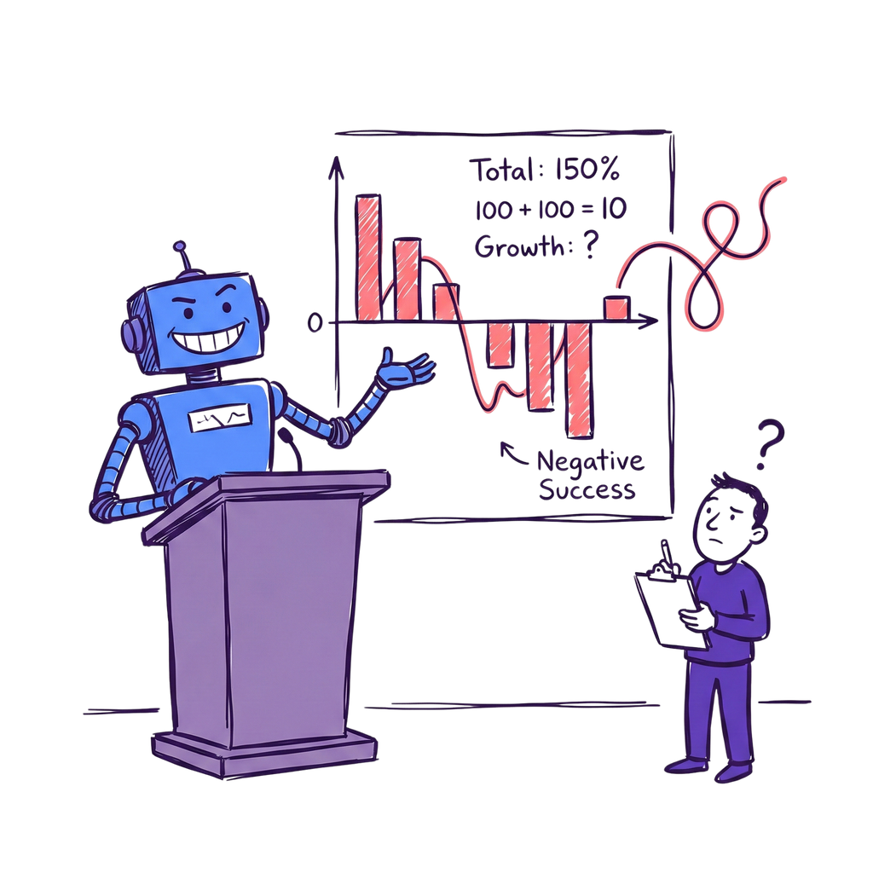
IT CAN BE CONFIDENTLY WRONG
It can sound certain and still be made up.
This is called hallucination. It will invent facts, names, figures and links that look completely real. For an audience that deals in accurate information, this matters.
YOU are always the editor.
Nothing goes out the door until a human has read it. A wrong answer looks exactly as polished as a right one.

Slide 8

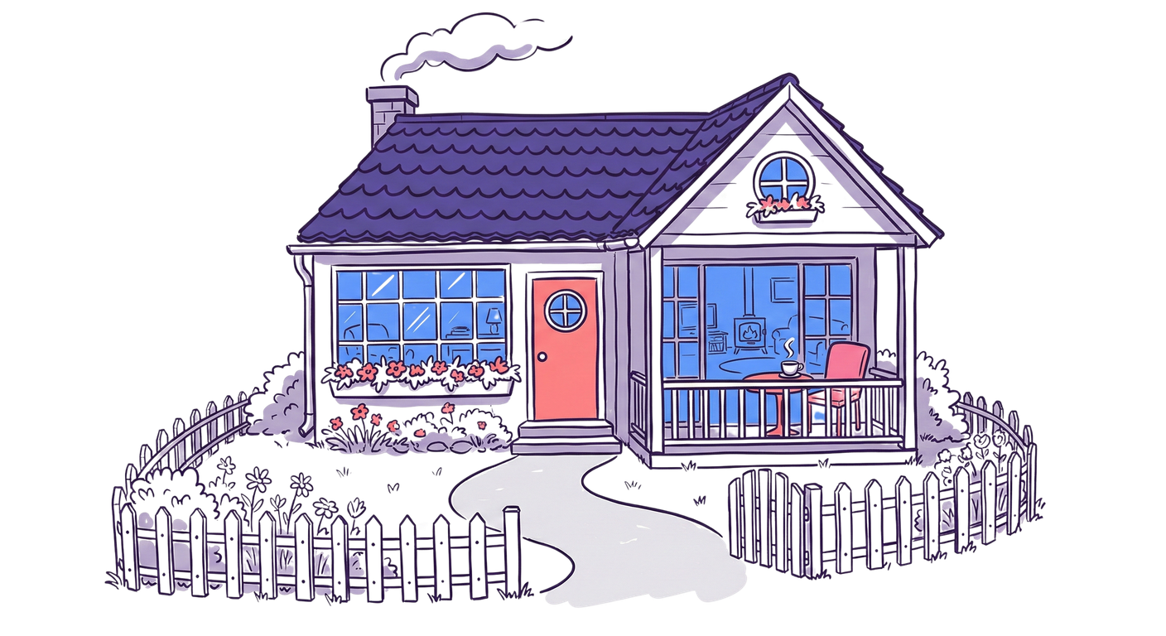
THE DREAM HOME
Imagine you're building your dream home
A table full of expert architects and builders, ready to give you exactly what you ask for.
"I'd like a house. A few bedrooms. A garden. A nice kitchen."
What could go wrong?

Slide 9

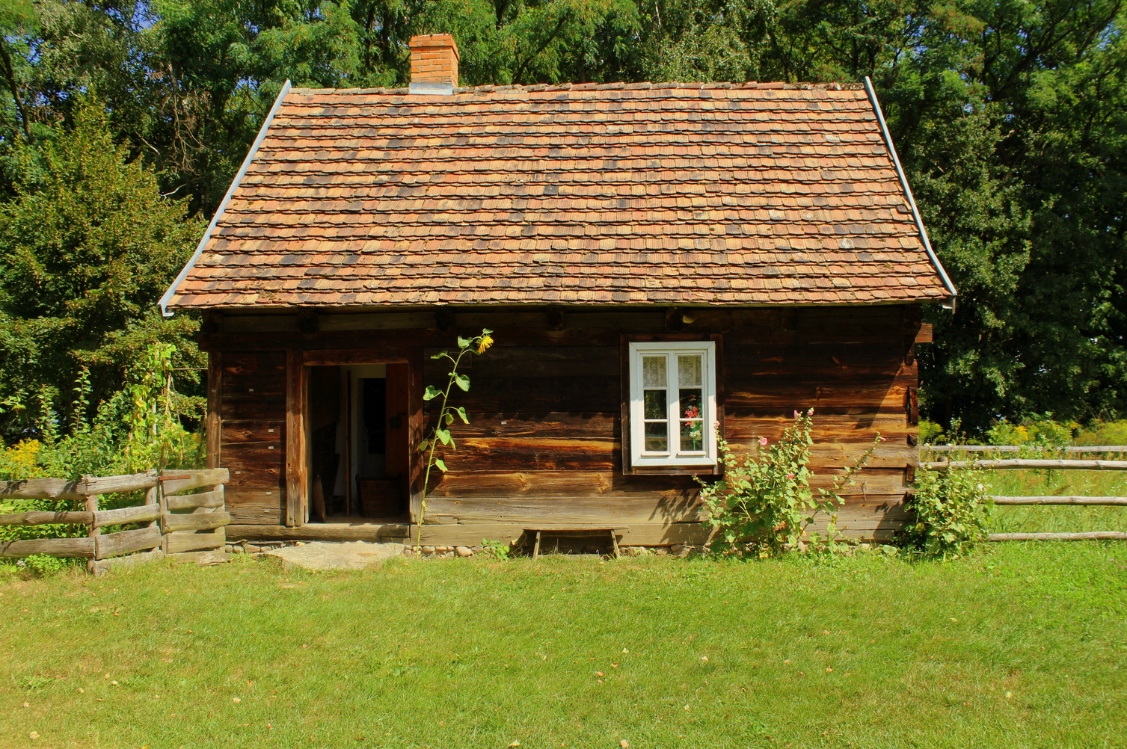

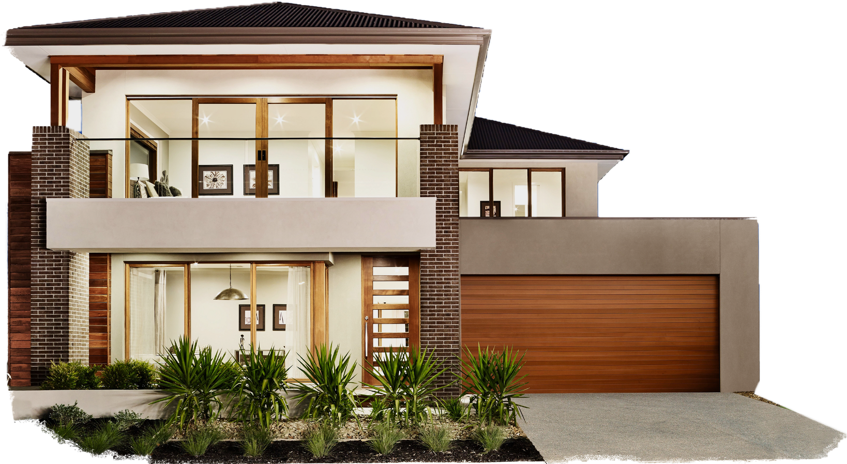
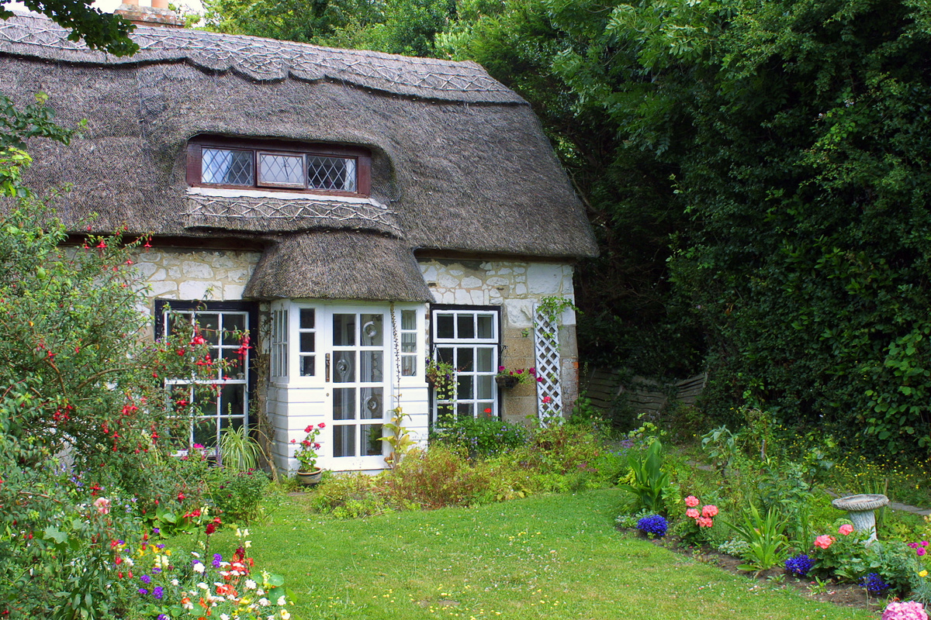


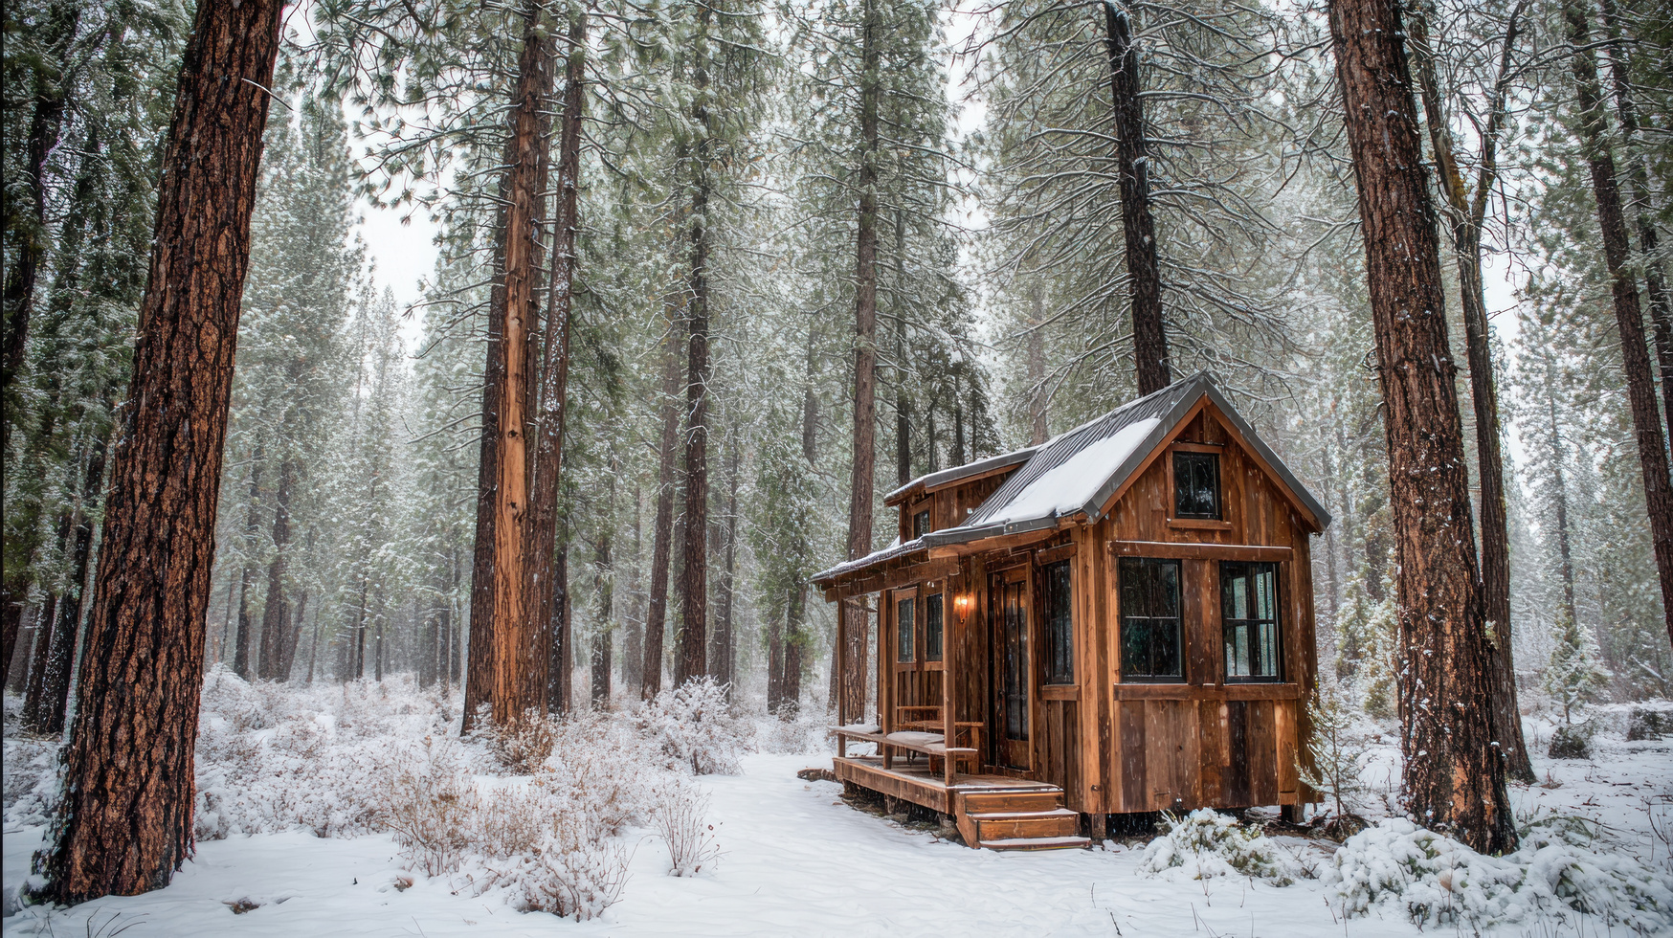

Slide 10

The Better Request
  "2 bedrooms, each at least 12 square metres, for our children ages 8 and 12"
  "Private, secure garden where children can play safely, with space for a trampoline"
  "Open-plan kitchen-living area for family meals and homework supervision"
  "Family bathroom with both bath and shower, accessible for elderly grandparents"
  "Budget: €180,000, completion by next Christmas"
  "We're a family of four who work from home twice a week"
  "Quiet rural location, traditional cottage style"

Slide 11
MEET THE PLAYERS:
The Big Five

Slide 12



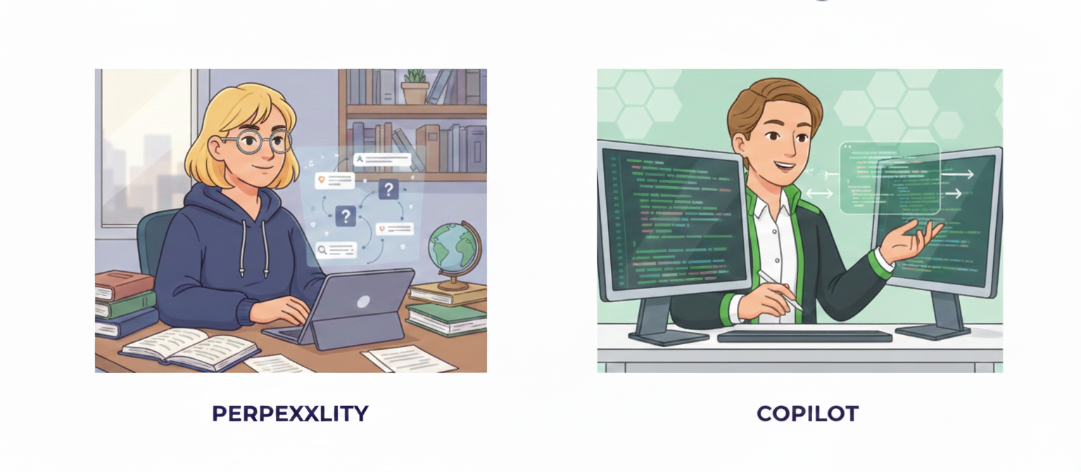
MEET THE PLAYERS
CHAT GPT
CLAUDE
GEMINI
PERPLEXITY
COPILOT

Slide 13
AI Tools Comparison
TOOL | BEST FOR | STRENGTHS | WATCH OUT
ChatGPT | General use, creative writing, drafting, versatile conversation | Strong all-rounder, handles long documents, wide range of add-on tools | Can be confidently wrong; free tier is limited; check your data settings
Claude | Long documents, PDFs, detailed analysis, natural writing tone | Excellent at analysis and careful writing; handles large documents well | Can be over-cautious; smaller free usage limits
Gemini | Google Workspace, multimodal tasks, video and audio | Deep Google integration; very long documents; can analyse video and audio | Best features cost extra; privacy settings take some digging

Slide 14
AI Tools Comparison
TOOL | BEST FOR | STRENGTHS | WATCH OUT
Perplexity | Research, fact-checking, anything that needs sources | Answers come with live citations you can click and check | Less creative; check its data retention settings; runs on other companies' models
Copilot | Microsoft 365 users, work-account tasks, document drafting | Enterprise data protection on a work account; sits inside tools you already have | How much it can reach depends on your licence; weaker at deep research

Slide 15

THE ONE RULE THAT NEVER BENDS
No student data. Nothing confidential. Ever.
Your organisation uses Microsoft 365 Copilot Chat. Signing in with your work account applies enterprise data protection automatically.
What happens to your data:
Chats are not used to train AI models and stay within the Microsoft 365 boundary.
But pasted content loses its labels and permissions — so the rule still stands.

Slide 16
PROMPTING ESSENTIALS:
The basics for all your work tasks

Slide 17
Why Most People Get Frustrated with AI
  Treat AI like Google search - typing keywords instead of having conversations
  No context - AI doesn't know who you are or what you do
  Vague, generic prompts - "Write social media posts" vs "Write Instagram posts for my handmade soap business"
  Accept first answer without refining - don't iterate or ask follow-up questions
  Expect mind-reading - assume AI knows your industry, audience, and goals
  One-size-fits-all approach - use the same prompt style for every task
  No relationship building - start fresh conversations instead of building context
RESULT: FRUSTRATED USERS GETTING GENERIC, UNHELPFUL RESPONSES THAT SOUND LIKE EVERYONE ELSE'S

Slide 18
The Golden Rule
ASK THE CHATBOT TO
ASK YOU QUESTIONS
Before diving into a task, tell the AI:
  "Ask me any questions you need to give me the best result."
  "What information would help you do this better?"
  "Interview me about this project first."
This flips the dynamic. Instead of guessing what context to give, the AI tells you what it needs. You'll often discover things you hadn't thought to mention.

Slide 19
The Building Blocks Formula
ROLE
TASK
CONTEXT
FORMAT
TONE

Slide 20
PROMPTING ESSENTIALS
Role
01
Who should the AI act as? This focuses the answer.
Examples:
“Act as an experienced curriculum designer reviewing this scheme of work.”
“You’re a literacy specialist helping me simplify a dense handout.”
“Act as a skeptical learner reading my assignment brief — tell me what isn’t clear.”
When to use: when you want specific expertise or a particular perspective, not a generic answer.

Slide 21
PROMPTING ESSENTIALS
Task
02
What do you want it to do? Be specific, not vague.
Vague: “Help me with this lesson.”
Specific: “Write five short-answer questions on photosynthesis for a mixed-ability class of 15-year-olds.”
Tip: one task at a time. Don’t ask for a lesson plan, a worksheet and a quiz in one go — break it up, or ask it to split the request into steps for you.

Slide 22
PROMPTING ESSENTIALS
Context
03
Who are you? Who are your learners? Why does this matter?
Without context: “Write a revision guide.”
With context: “I teach an evening class of adult returners. Many have been out of education for years and lose confidence when the language gets technical.”
Context helps it understand:
Your subject, and the level you teach
Who your learners are and what they find hard
Constraints — time, reading age, assessment rules
The stakes — a five-minute starter or a graded assessment

Slide 23
PROMPTING ESSENTIALS
Format
04
How do you want the output? Don’t leave it to guess.
Examples:
“Give me a table with question, answer and marks.”
“Three bullet points a learner could read in a minute.”
“Keep it under 200 words, at a reading age of 12.”
“Write it as a handout, not an essay.”
Tip: ask for variations — “give me three versions at different difficulty levels” saves you rewriting.

Slide 24
PROMPTING ESSENTIALS
Tone
05
How should it sound? This is the one that stops the output sounding like a machine.
Examples:
“Here’s a handout I wrote — match this tone.”
“Warm and encouraging, plain English, no jargon.”
“Write it the way I’d say it out loud to a learner.”
Best of all: write a tone and voice guide once, save it, and attach it every time. We build one later today.

Slide 25
DEEP DIVE:
CO-PILOT

Slide 26

THE GREEN SHIELD:
ENTERPRISE DATA PROTECTION
  Your data stays private - not used to train AI
  Your data is not shared with the model providers
  Prompts and responses stay within your organisation's boundary
  Complies with GDPR and enterprise compliance standards

Slide 27
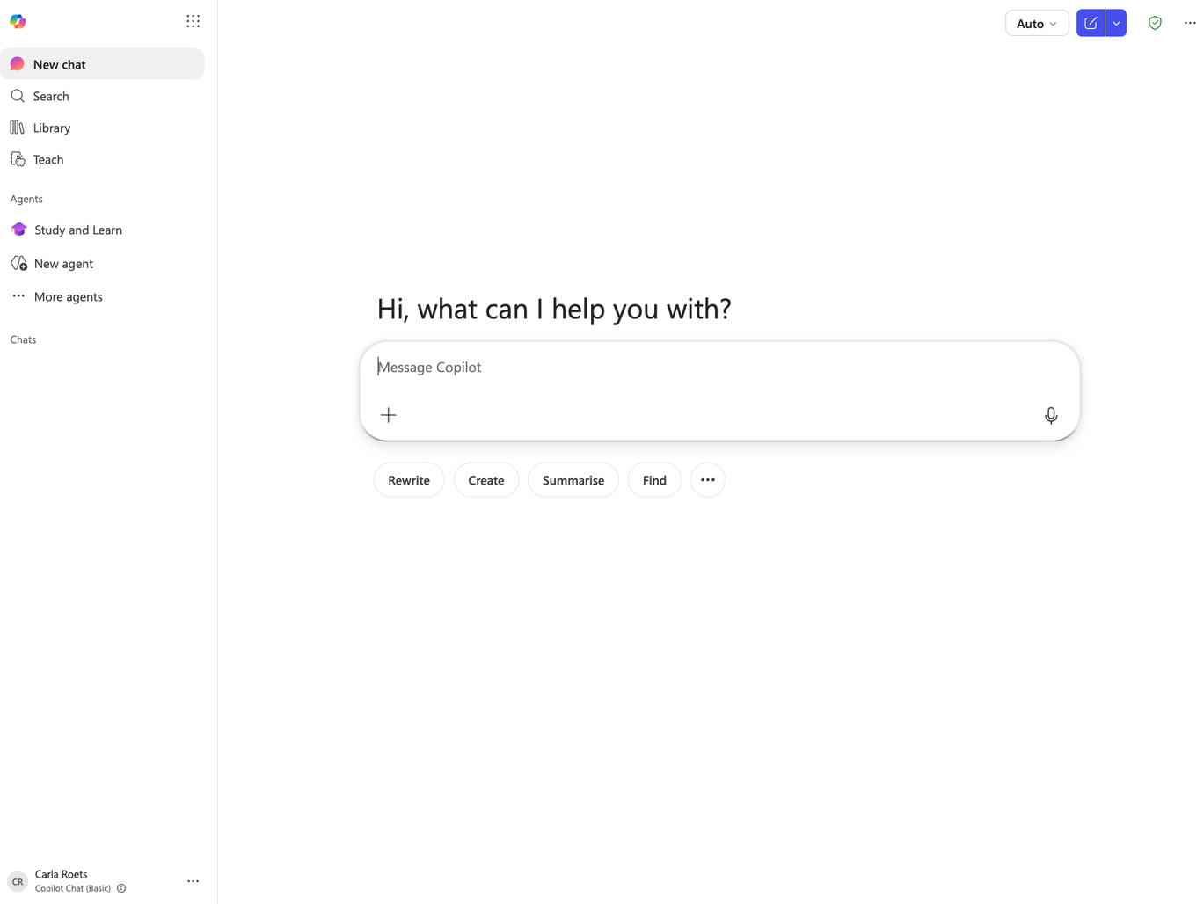
WHERE TO FIND IT AND SIGN IN
01
Go to microsoft365.com
02
Sign in with your work account
03
Look for the Copilot icon
This is Copilot Chat, the free tier. Everything happens in the chat.

Slide 28
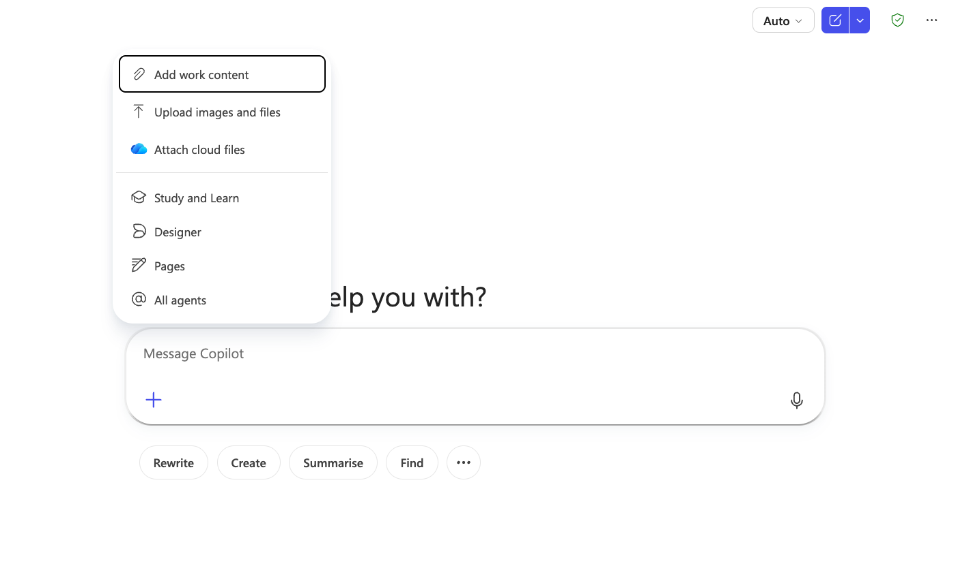
THE CHAT WINDOW
3
1
Type your prompt and press send to start
2
Ask a follow-up to refine the answer, you don't start over each time
3
Start a fresh chat when you move to a new task, so it isn't muddled by the last one
1
2

Slide 29
MEET COPILOT
The interface, at a glance
2
1
01
New chat - start fresh, clears the conversation
02
Auto - lets Copilot pick the model for you
5
03
Add content (+) - paste text or upload files
6
04
Microphone - dictate instead of typing
05
Designer - generate images from a description
3
4
06
Pages - turn a chat into a shareable doc

Slide 30
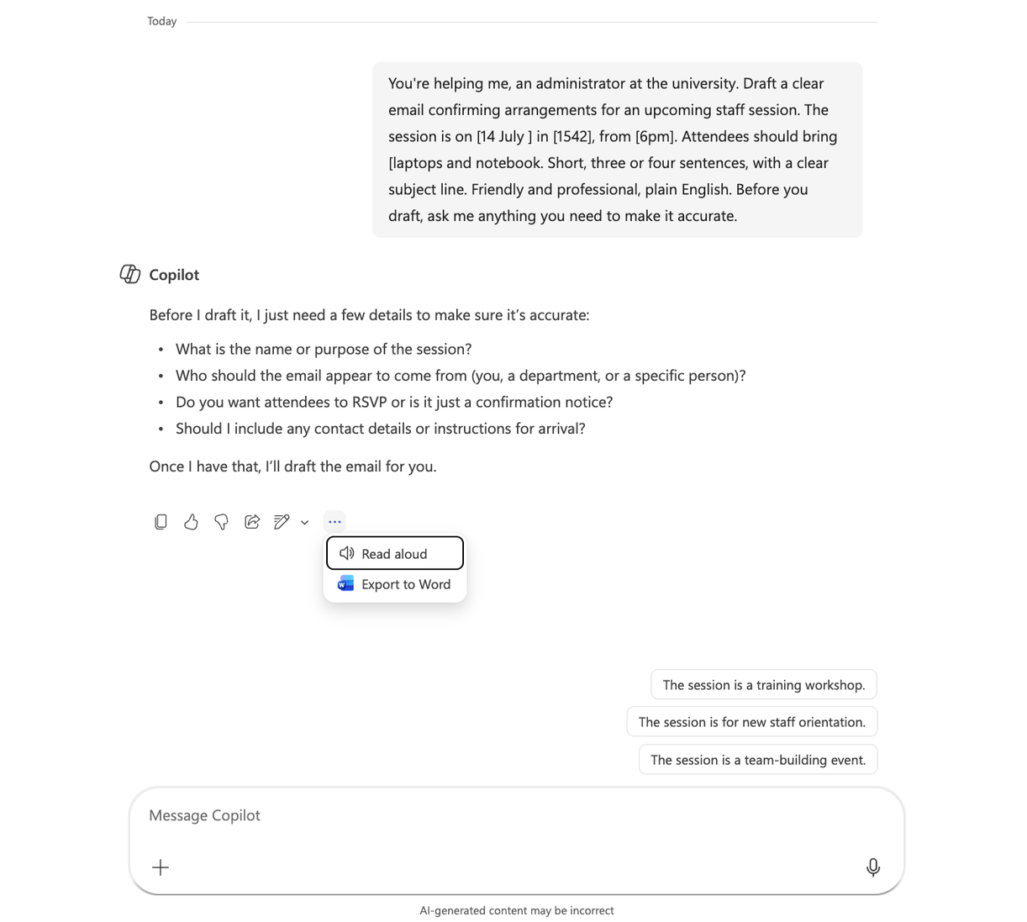
MEET COPILOT
Modes & response tools
MODES
Chat - default conversational mode
Designer - generate images from a description
Research - web-sourced, deeper answers
1
2
Pages - turn a chat into a shareable doc
3
AFTER COPILOT REPLIES
01
Copy - copy the answer to paste elsewhere
02
Read aloud - listen to the response
03
Export to Word - drop the reply into a Word doc

Slide 31
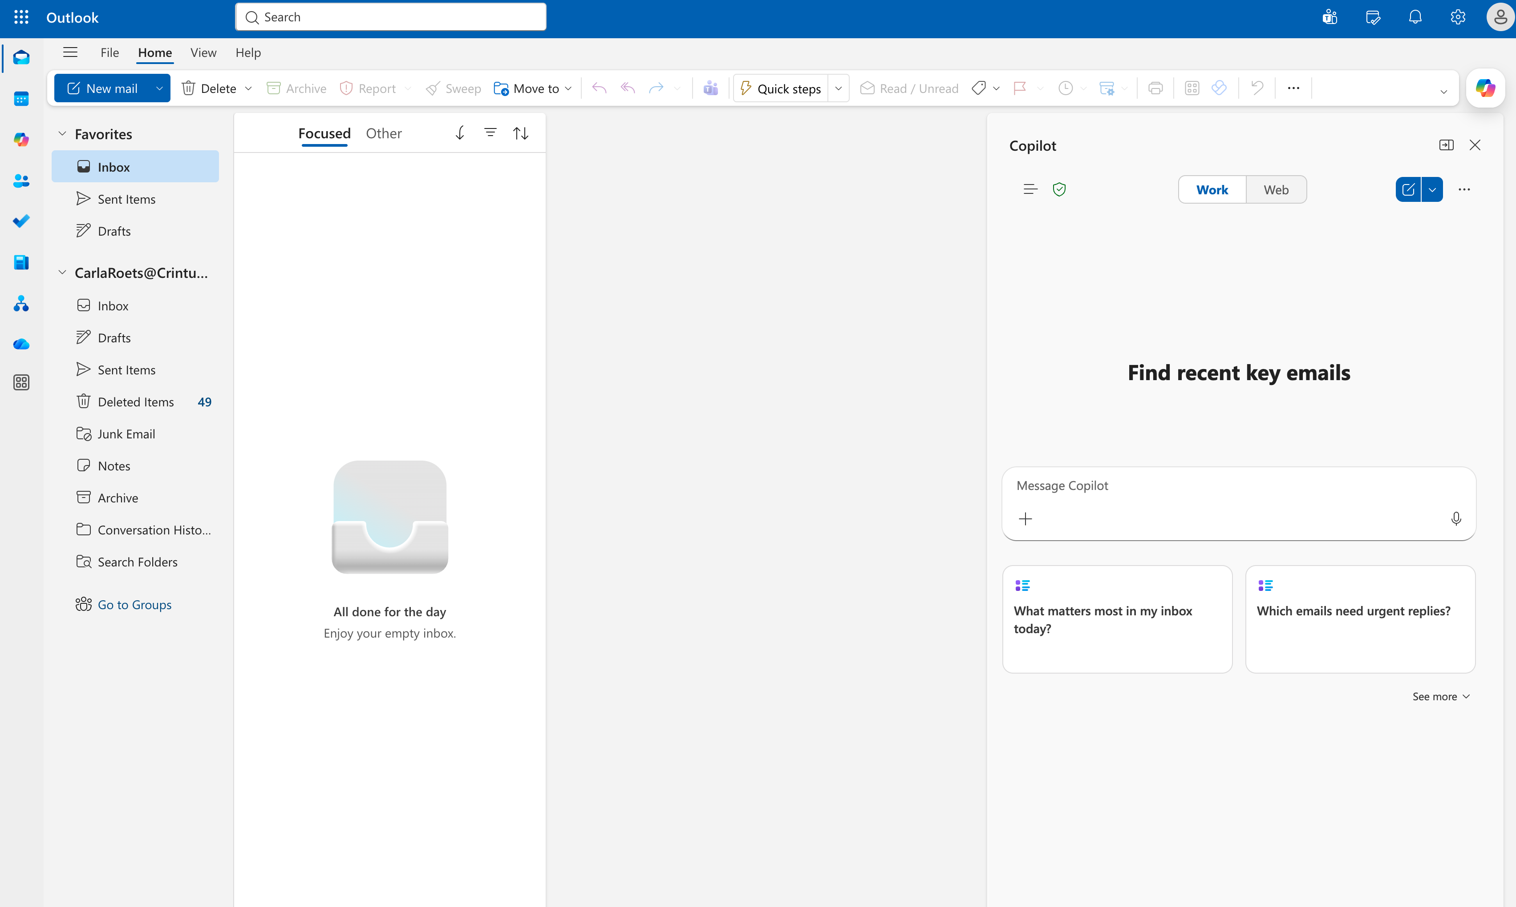
MEET COPILOT
Copilot in your email, too
1
2
THE TOGGLE THAT MATTERS
Work - your own inbox and calendar
Web - the open internet, it can't see your mailbox
Tip - if it seems blind to your inbox, check this toggle first
3
Not showing? Use Outlook on the web
SPOT THESE THREE
01
Copilot button - opens the pane in new Outlook and web
02
Work / Web - check it before you judge the answer
03
Suggested prompts - one-click starters for your own inbox

Slide 32
WHAT IT CAN AND CAN'T DO IN YOUR EMAIL
It can, in Outlook
It can't, and won't
Summarise a long thread in seconds
Send anything. You always review and press send
Find and sum up emails about a topic or person
See shared inboxes, it only reads your own mailbox
Draft a reply, or a polite chase-up, in your tone
Reach your Teams chats or other systems on this licence
Answer questions about your calendar and meetings
Be trusted without checking, it can invent things
Turn a thread into action points
Do all of it inside your organisation’s data boundary
Remember earlier chats, each one starts fresh

Slide 33
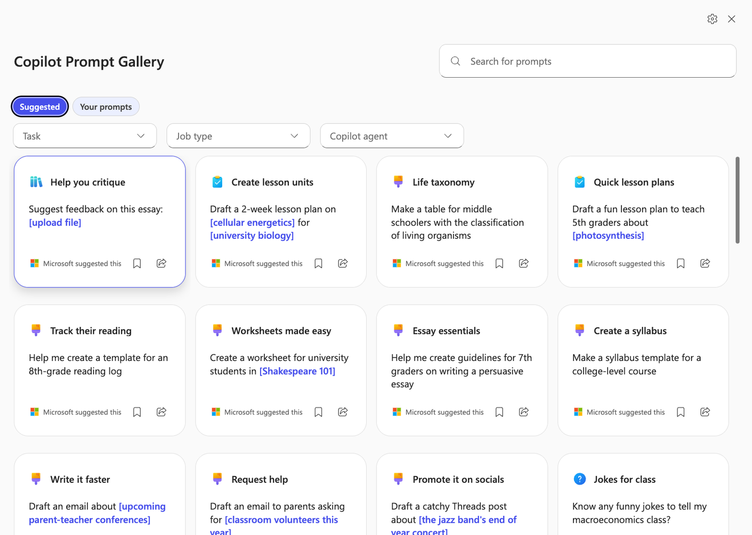
WRITE IT WELL ONCE, REUSE IT FOREVER
Your good prompts are worth keeping. Save them so you're not rewriting the same thing every week.

Slide 34
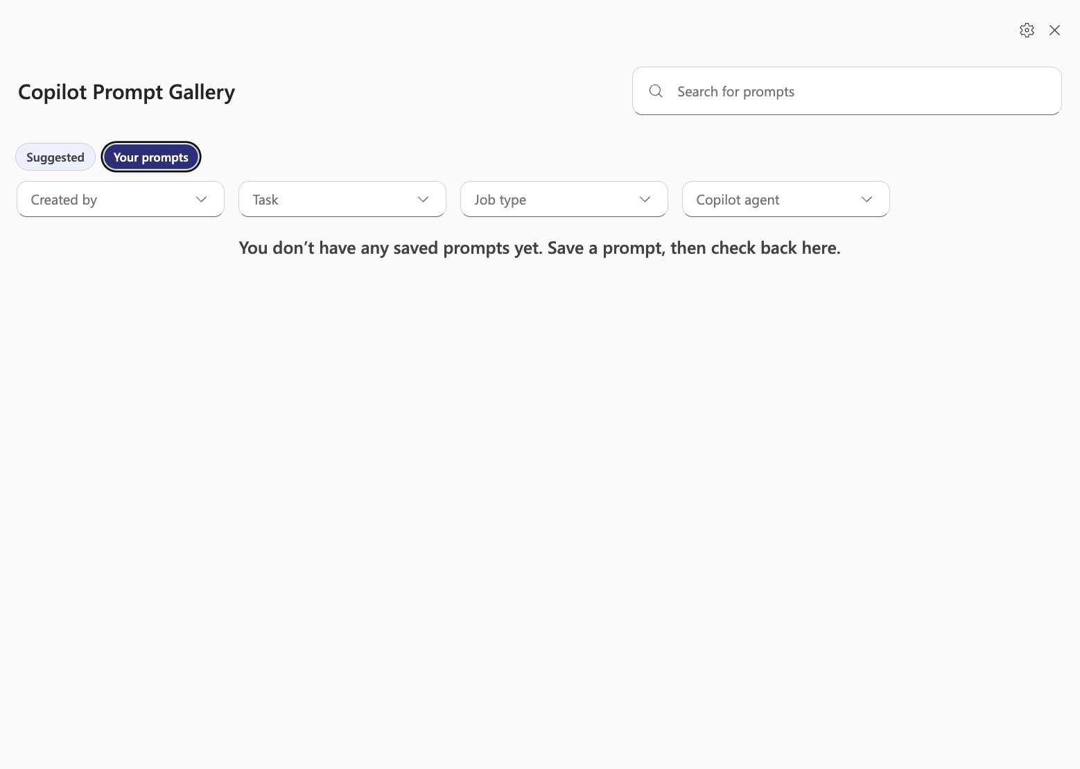

Slide 35
What Copilot can and can't do (honest version)
Strengths
Limitations
  Type “/” to pull in your OneDrive and SharePoint files
  Summarising documents you point it at or upload
  Drafting and rewriting anything
  Enterprise data protection on your work account
  Free, on current models
  You point it at files — it won’t search everything for you
  Doesn’t work inside Word, Excel or PowerPoint on this licence
  Weaker at deep research than Perplexity
  One task at a time — it drifts on long chains
  It can still be confidently wrong

Slide 36

LET’S PRACTICE

Slide 37
DEEP DIVE:
GEMINI

Slide 38

What can Gemini do?
  Chat and write (drafts, brainstorming, summarising, explaining)
  Create images (generate graphics from text descriptions)
  Analyse documents (upload PDFs, images and long documents)
  Research with sources (web search built in, answers with links)
  Work with Google apps (Drive, Gmail and Docs — paid tiers only)
  Voice conversations (Gemini Live — talk instead of type)

Slide 39
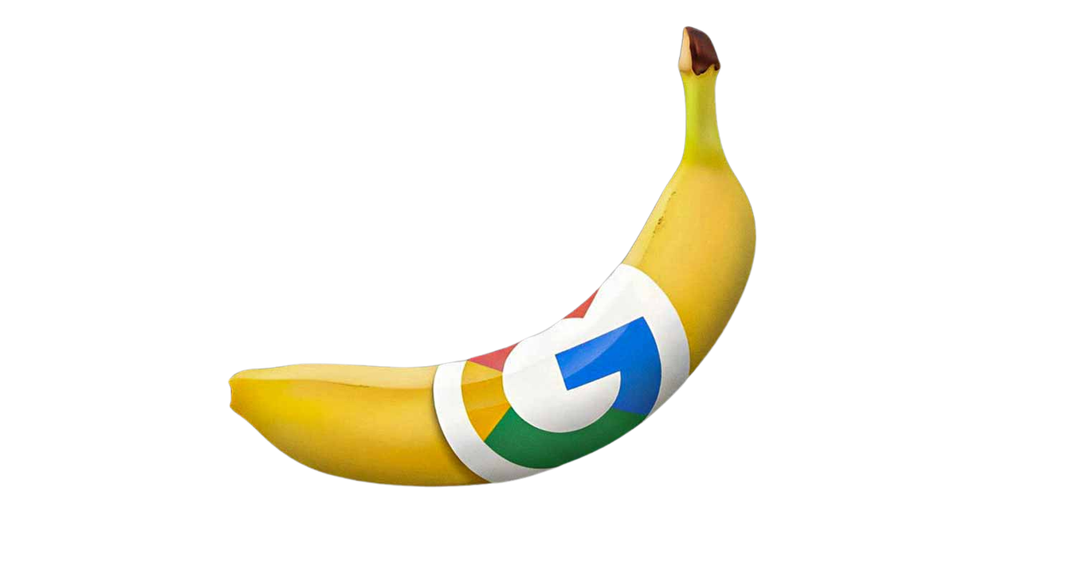
What Gemini is especially good at
  Image generation built in (no separate tool needed, free)
  Long documents and video — the biggest capacity sits on paid tiers
  Google ecosystem integration (Drive and Gmail on paid tiers)
  Free tier is capable, with daily caps — Gems, image creation and file uploads all included
  Good for visual prompting demos

Slide 40
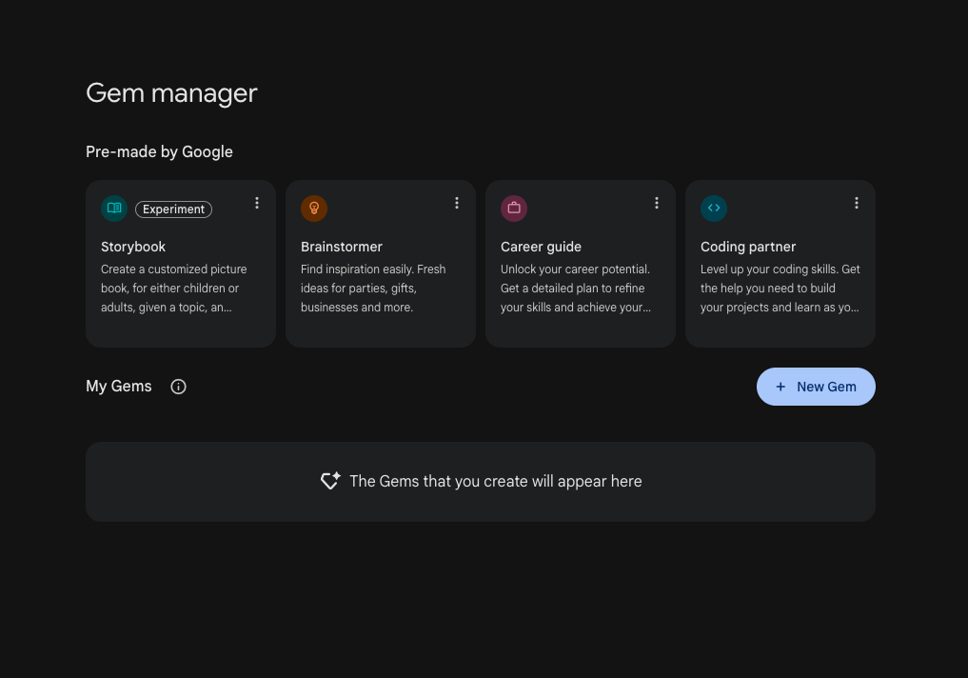
What are Gems?
  Custom AI experts you create for repeated tasks
  Like saving your perfect prompt so you don’t have to rewrite it every time
  Free for all users (create at gemini.google.com)
  You give it: a name, instructions, and optional files for context
  Gemini has a “magic wand” that expands short instructions into detailed ones
  Keep your instructions written down — every app builds these a different way

Slide 41
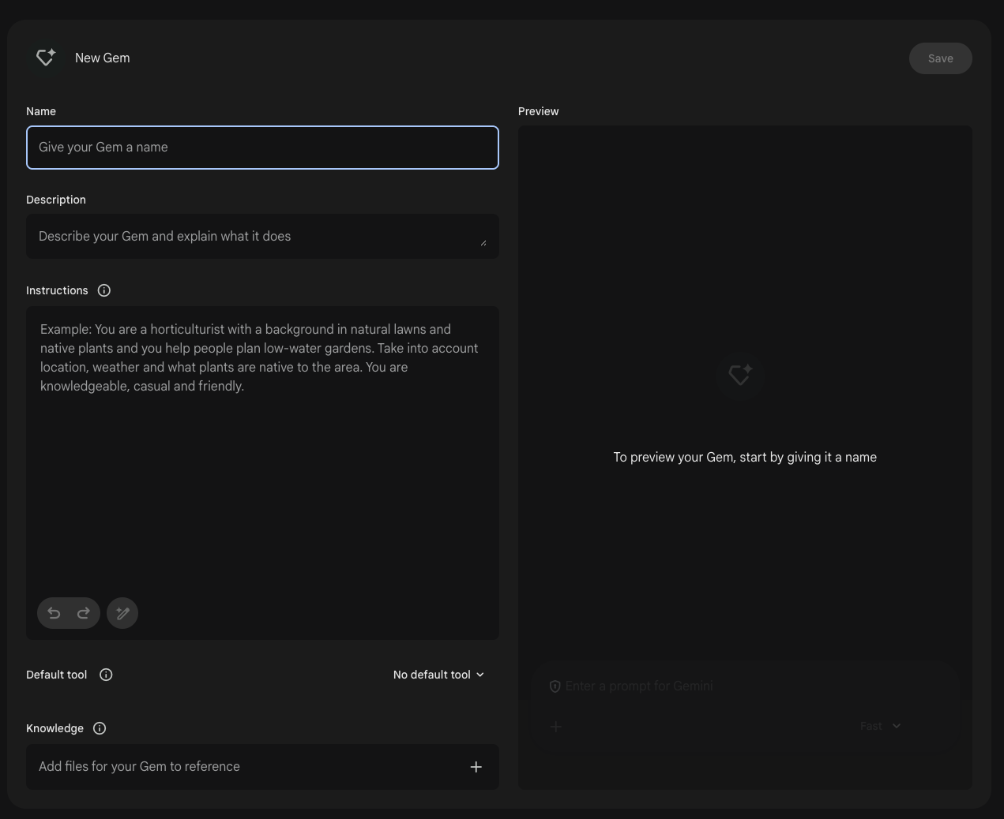
  Open Gems in the left sidebar — first time, go to Settings and help, then Gems
  Click “+ New Gem” at the top of the panel
  Name your Gem (e.g. “Tutor Assistant”)
  Write your instructions (or write a sentence and click the magic wand to expand)
  Upload files for context (up to 10 files, each up to 100MB — course specs, templates, learner profiles)
  Preview it on the right, then click Save
  Your Gem appears in the sidebar ready to use anytime

Slide 42
What each one can actually see
Copilot
Gemini
  Your OneDrive and SharePoint files, via “/”
  Files you upload to the chat
  The web, if web search is switched on
  All of it inside your work data boundary
  Your Google account, if you connect it
  Drive, Gmail and Docs — paid tiers
  Files you upload — including video and audio
  The web, with sources you can click

Slide 43
Which one, for teaching work?
Copilot
Gemini
  Safer default for anything touching learner data
  Already there if your centre runs Microsoft
  Familiar, so less to learn
  You point it at files, one at a time
  Gems save a reusable expert, free
  Strong on long documents, video and audio
  Best for images and visual demos
  Think twice before it sees learner data

Slide 44
LET’S PRACTICE

